Slide 1
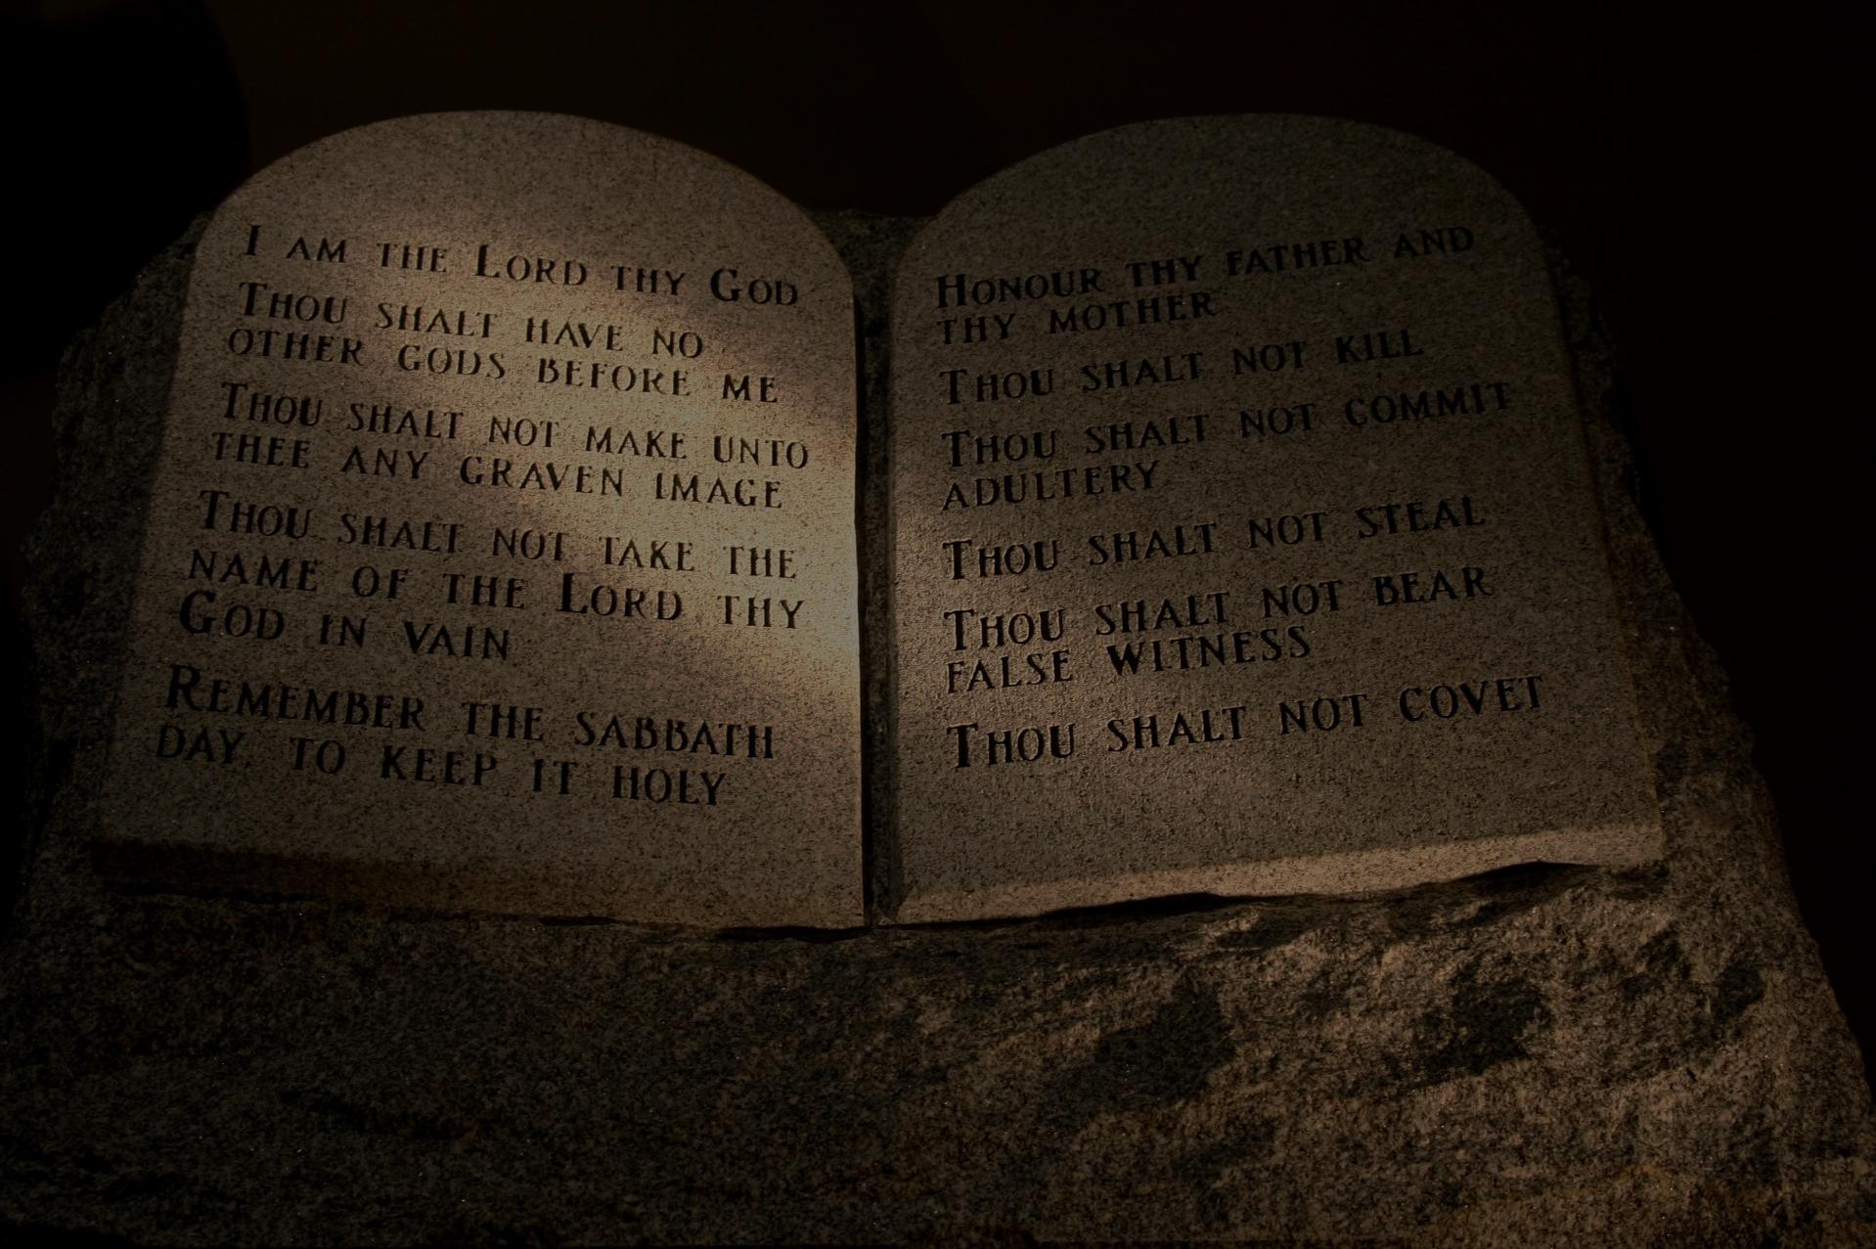
Are We Justified by the Law of Moses?
By
Willie Alvarenga

Slide 2

An Overview of Our Lesson

Slide 3

Overview of our lesson:
The context of the Book of Romans in relation to the law of Moses and the doctrine of justification
Biblical reasons why the law of Moses cannot justify men today
The serious consequences of trying to seek justification through the law of Moses
The biblical location & manner of true justification

Slide 4

Acts 17:11
I Thessalonians 5:21
I John 4:1

Slide 5

We can
Understand
The Bible
John 7:17
John 8:32
Eph. 3:4
Eph. 5:17

Slide 6
Clarifying Some Terms
Are we justified by the law of Moses?
By “we” we refer to every living person today.
By “justified” we refer to the act of rendering someone just or innocent before God, to declare righteous (W.E. Vine).
By the “law of Moses” we refer to the Old Testament law given specifically to the Jewish nation, and not to people living on Earth today.

Slide 7

I. The context of the Book of Romans in relation to the law of Moses and the doctrine of justification.

Slide 8
What is the central theme of the Book of Romans?
The Gospel of Christ is God’s power to the salvation of men.
The Book of Romans clearly reveals the truth that justification is obtained by means of an obedient faith in Christ (cf. Romans 1:5; 16:26; 3:23).

Slide 9

Why did the Apostle Paul write Romans and Galatians?
The apostle wanted to teach God’s way on how to obtain justification.
There were some Jews in the first century who believed and taught that man is justified by keeping the law of Moses (cf. Acts 15).

Slide 10
Overview of the first seven chapters of Romans
Chapter one: Gentiles are lost in sin and stand in need of justification.
Chapter two: The Jews are lost in sin and stand in need of justification.
Chapter three: Gentiles and Jews are lost in sin and stand in need of justification.
Chapter four: Abraham, a powerful argument to show that justification comes through an obedient faith.

Slide 11
Overview of the first seven chapters of Romans
Chapter five and eight: The great blessings those who have been justified enjoy in Jesus Christ.
Chapter six: The reality of sin and how the grace of God through Jesus Christ can help men to overcome sin.
Chapter seven: We are no longer living under the law of Moses but the Law of Christ.

Slide 12
II. Some reasons why the law of Moses cannot justify men today.

Slide 13
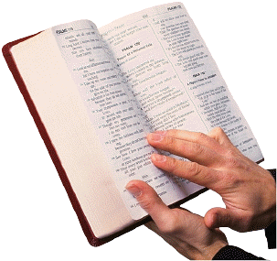
Reason # 1:
The apostles’ doctrine clearly teaches that man cannot be justified through the law of Moses.

Slide 14

Consider the biblical evidence
Paul established this point when he was preaching at Antioch of Pisidia (cf. Acts 13:39).
Paul made the same argument when he wrote to the saints at Rome (cf. Romans 3:20, 28).
The Apostle Peter taught the same thing at the Jerusalem council (cf. Acts 15:8-11).

Slide 15
Reason # 2:
Men today are not under the law of Moses, but the Law of Christ.

Slide 16
Consider the Biblical Evidence
A change of law was prophesied under the Old Testament (cf. Jeremiah 31:31-34).
Moses taught that a new Prophet would come, and that people needed to listen to Him (cf. Deuteronomy 18:15-18; cf. Acts 3:22-26).
God Himself taught us to listen to Jesus, not Elijah, or Moses (cf. Matthew 17:1-5).

Slide 17
Consider the Biblical Evidence
  The truth that we no longer live under the Old Testament law was emphasized by the apostle Paul and others (cf. Romans 7:1-6; Galatians 4:4-5; Ephesians 2:13-16; Colossians 2:14 and Hebrews 8:7-13).
  Jesus himself also made the argument that we are under His New Law, not the law of Moses (cf. Matthew 5:21-22, 27-28, 33-34, 38-39; 26:28).
  Justification cannot be obtained through the law of Moses, but only through Jesus Christ (cf. Galatians 2:16; Acts 13:39).

Slide 18

Consider the Biblical Evidence
  Notice what Brother Wayne Jackson commented concerning this point under consideration, “This ‘justification’ status, Paul says, cannot be achieved by means of the Mosaic law. And why not? Because the Old Testament had only the offerings of animals, which could never, on an ultimate basis, remedy sin (Heb. 10:1-4). If salvation could have been accessed, strictly on the basis of Moses’ law, then Jesus died needlessly (Gal. 2:21). Christ had to function as the Lamb of God for the potential benefit of humanity in every historical period (Gal. 4:4; Heb. 9:15).
Jackson, Wayne, The Acts of the Apostles from Jerusalem to Rome, 2nd Ed. (Stockton, California: Christian Courier Publications, p. 158-159

Slide 19
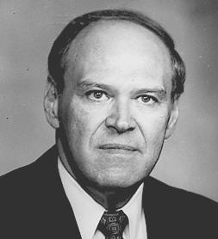
Alan E. Highers on the difference between the Old and the New Testament
  “There is a difference between the law and the gospel. The gospel is the power of God unto salvation (Rom. 1:16), but those who would be justified by the law are fallen from grace (Gal. 5:4). Therefore, the animal sacrifices, Sabbath observance, instrumental music and other practices under the law do not constitute the pattern for us today”
Alan E. Highers, The New Testament is the Pattern for Men Today, p. 296 (Rightly Dividing the Word: Volume I—General Hermeneutics, The Fourth Annual Shenandoah Lectures, editor Terry M. Hightower, 1990

Slide 20
As we can see, there is plenty of evidence that proves we are not under the law of Moses, but under the Law of Christ.
Sadly to say, there are many who still believe that they are obligated to keep the law of Moses. The internal evidence from Scripture we have considered clearly teaches that this cannot be the case.

Slide 21
III. The Serious Consequences of Seeking Justification through the Law of Moses.

Slide 22
What are the terrible consequences of seeking justification through the law of Moses?

Slide 23
Consequence # 1: You are guilty of teaching something that goes contrary to the Word of God.
  The Bible nowhere teaches that justification comes through the law of Moses.
  We have a great responsibility of teaching only that which God authorizes in His Word (cf. 1 Peter 4:11; Titus 2:1; Colossians 3:17).

Slide 24
    To teach something the Bible does not teach is to be guilty of perverting the Scriptures. This is exactly what some Jews were doing! An anathema awaits those who pervert the gospel of Christ (cf. Galatians 1:6-9).

Slide 25
Consequence # 2: You would have committed spiritual adultery.
  The Bible teaches that if you try to keep the law of Moses, you are guilty of spiritual adultery (cf. Romans 7). Paul argued that we are married to Christ, and not to Moses (vs. 4).
  Spiritual adultery takes place when we forsake God to go after others things that go contrary to His will (cf. James 4:4).

Slide 26
Consequence # 3: Christ would have died in vain if justification came through the law of Moses.
  This is what you and I would be teaching if we argued that justification came through the law of Moses and not through Christ’s Law.
  This is the argument that Paul conveyed to the Galatians (cf. Galatians 2:20-21).
  Christ’s death had the purpose of establishing a New Covenant so that man can be justified through His Law, and not the law of Moses. To say that man can obtain justification through the law of Moses is to say that what Christ did on the cross was in vain. This certainly cannot be the case.

Slide 27
Consequence #4: Man would have to keep the whole law of Moses.
  This is what Paul conveyed to the Galatians:
  “For as many as are of the works of the law are under a curse: for it is written, cursed is every one who continueth not in all things that are written in the book of the law, to do them” (Galatians 3:10; Deuteronomy 27:26, emp. added).

Slide 28
Consequence # 5: Salvation is lost.
  There is no salvation whatsoever to those who are trying to be justified through the law of Moses:
  “Ye are severed from Christ, ye who would be justified by the law; ye are fallen away from grace (Galatians 5:4, emp. added).

Slide 29
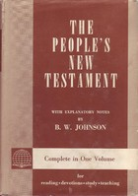
B.W. Johnson
People’s New Testament Explanatory Notes
  “Their circumcision, under the circumstances, would be the sign of their submission to the law of Moses. They, Gentile Christians, could not thus become Jews and remain Christians. It would be a proof of trust in Moses rather than Christ, in the law rather than in the gospel” (p. 179).

Slide 30
  You can be the best person in the entire world, but if you seek to be justified through the law of Moses, you have lost everything.

Slide 31
IV. The Location & Manner of True Justification.

Slide 32

The location of our justification

Slide 33
Consider the teaching of the Bible
“And by him every one that believeth is justified from all things, from which ye could not be justified by the law of Moses” (Acts 13:39, emp. added).
“In whom we have our redemption through his blood, the forgiveness of our trespasses, according to the riches of his grace” (Ephesians 1:7, emp. added).

Slide 34
Consider the teaching of the Bible
“yet knowing that a man is not justified by the works of the law but through faith in Jesus Christ, even we believed on Christ Jesus that we might be justified by faith in Christ, and not by the works of the law: because by the works of the law shall no flesh be justified” (Galatians 2:16, emp. added).
“Being justified freely by his grace through the redemption that is in Christ Jesus” (Romans 3:24, emp. added

Slide 35
Consider the teaching of the Bible
“Being therefore justified by faith, we have peace with God through our Lord Jesus Christ; through whom also we have had our access by faith into this grace wherein we stand; and we rejoice in hope of the glory of God” (Romans 5:1-2, emp. added).
“On the morrow he seeth Jesus coming unto him, and saith, behold, the Lamb of God, that taketh away the sin of the world!” (John 1:29, emp. added).

Slide 36
Consider the teaching of the Bible
“Who gave himself for our sins, that he might deliver us out of this present evil world, according to the will of our God and Father” (Galatians 1:4, emp. added).
“My little children, these things write I unto you that ye may not sin. And if any man sin, we have an Advocate with the Father, Jesus Christ the righteous: and he is the propitiation for our sins; and not for ours only, but also for the whole world” (1 John 2:1-2, emp. added).

Slide 37
As we can see, there is no doubt in our minds that the location for our justification is found in Christ Jesus.
  This is the location where all the spiritual blessings are found (Ephesians 1:3).

Slide 38
Let us now consider the manner by which justification is obtained

Slide 39
The Judaizing Teachers
Acts 15:1-5
Circumcision + Keeping the
law of Moses =
Salvation

Slide 40
Mark 16:16 According to the Judaizers
He that believes and is baptized and is circumcised and keeps the law of Moses shall be saved

Slide 41
The Apostles’ Doctrine
  Man must hear the gospel of Christ (cf. Romans 10:17; 1 Corinthians 15:1-4; Romans 1:16).
  Man must believe in the Son of God (Mark 16:16; John 3:16). Must have an obedient faith.
  Man must repent of his sins (Acts 2:38; 17:30).
  Man must confess Christ as the Son of God (Acts 8:37; Romans 10:9-10).
  Man must be baptized for the remission of sins (Acts 2:38; 22:16).
  Man must live a faithful life in Christ (Philippians 2:12; cf. Revelation 2:10).

Slide 42
When the person is baptized…
  He is baptized into Christ Jesus (Romans 6:3-4; Galatians 3:27; cf. Acts 2:47).
  Let us remember that “in Christ” is where we find justification (cf. Romans 3:24; Ephesians 1:7), reconciliation (cf. Ephesians 2:13-16), eternal life (cf. 1 John 5:11; John 11:25), and many more blessings (cf. Ephesians 1:3).

Slide 43
Are We Justified by the Law of Moses?
If we reason correctly, the answer will be NO!

