Slide 1

CHRIST AS THE LIGHT OF YOUR WAY
By
Willie Alvarenga

Slide 2

A GREAT GOSPEL MEETING
We will be studying about the Savior of the World: Jesus Christ (I Corinthians 2:2; II Corinthians 4:5)
We will have the opportunity to invite friends to come and hear the Word of God (Acts 10:24; Mark 16:15)
We will have the opportunity to enjoy the beautiful fellowship with one another (Psalm 133:1; Acts 2:42, 46)

Slide 3
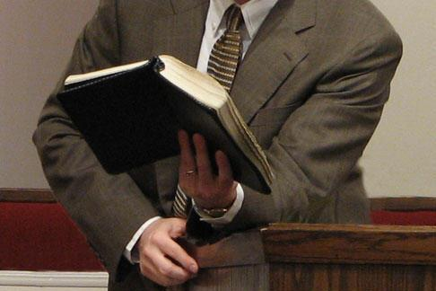
CONSIDER THE FOLLOWING PASSAGES BEFORE OUR LESSON
ACTS 17:11
I THESSALONIANS 5:21
JOHN 7:17
JAMES 1:22

Slide 4
CHRIST AS THE LIGHT OF YOUR WAY
MAIN POINTS:
  Who Jesus Christ Is
  Why men needs Jesus Christ as the Light of their way
  How can men come to Jesus and enjoy the Light He provides

Slide 5

If we want Christ to be the Light of our way, we must acknowledge who He is!

Slide 6
Who Is Jesus Christ?
He is the beloved Son of God (Matthew 17:5)
He is the Creator of the World (John 1:1-3; Colossians 1:16)
He is the Savior of the World (Matthew 1:21; I Timothy 1:15; Luke 19:10)
He is the only Door to salvation (John 10:9; Acts 4:12)
He is the Way, the Truth and the Life (John 14:6)
He is our Redeemer (I Peter 1:18-20)
He is Deity (John 1:1-3; Colossians 2:9; John 8:58; John 10:30)
He is our Mediator (I Timothy 2:5)
He is our Judge (II Corinthians 5:10; II Timothy 4:7-8)
He is the Light of the World (John 8:12)

Slide 7
Why do men need Jesus Christ as the Light of their way?
Reason # 1 Man cannot guide his own steps in this world
  This world is in darkness (Colossians 1:13; I John 5:19)
  The Bible teaches that man alone cannot guide his own steps (Jeremiah 10:23; Proverbs 14:12; 16:25; John 15:5; 12:35)
  Jesus, being the Light of this world, is the only One that can guide man’s ways (John 8:12; 9:5; 12:46)

Slide 8
Why do men need Jesus Christ as the Light of their way?
Reason # 2 Jesus Christ is the only One that can guide your way out of sin & darkness
  The Bible teaches that all men outside of Christ are in sin & darkness (Romans 3:23; Ecclesiastes 7:20)
    Sin is the breaking of God’s Law (I John 3:4; 5:17; James 4:17; Proverbs 24:9)
  The consequences of sin are terrible:
    Slavery to sin (John 8:34; Romans 6:16)
    Separation from God (Isaiah 59:1-2; James 4:4)
    Eternal Death (Romans 6:23)

Slide 9

Jesus Is The Answer To The Sin Problem
He came to seek and save the lost (Luke 19:10)
He came to save sinners (I Timothy 1:15; Matthew 1:21; Romans 6:23; John 1:29)
He is the only One that can give you forgiveness of sin (Ephesians 1:7; Colossians 1:13; Mark 2:10)

Slide 10
How Can Men Come To Christ, The Light Of The World?
Man MUST trust in Jesus & God (Proverbs 3:5-6)
Man MUST determine in his heart to follow God and reject sin / darkness (Joshua 24:15; John 3:19)
Man MUST obey the Gospel of Christ
  Purpose of the gospel is to turn people from darkness to light (Acts 26:18)

Slide 11
HOW CAN MAN OBEY THE GOSPEL OF CHRIST?
He must hear the gospel of salvation (Romans 10:17;Acts 18:8; I Corinthians 15:1-4)
He must believe in the gospel (Mark 16:16)
He must repent of his sins (Acts 3:19; 17:30)
He must confessed Christ as the Son of God (Romans 10:9; Acts 8:37)
He must be baptized in order to have his sins forgiven (Acts 2:38; 22:16; Mark 16:16; I Peter 3:21)
He must be faithful unto death (Revelation 2:10; Philippians 2:12)
The Biblical Plan of Salvation

