Slide 1

History of Music and Its Function In the New Testament
Willie Alvarenga
Willie.alvarenga@browntrailschoolofpreaching.com

Slide 2
OVERVIEW OF OUR LESSON
We will discuss our present condition with regards to the subject at hand
We will discuss what the Bible says about the kind of music God desires
We will consider some quotes from denominational leaders who opposed the use of mechanical instruments in the N.T. period

Slide 3
OVERVIEW OF OUR LESSON
We will discuss reasons why faithful churches of Christ do not use instruments in worship
We will discuss additional arguments used to justify the use of instruments

Slide 4
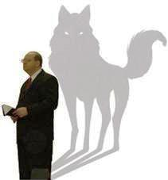
There is a sad reality going on in some churches of Christ today: Many are introducing false teaching to the church, specially on the use of mechanical instruments

Slide 5
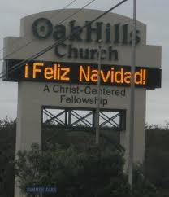
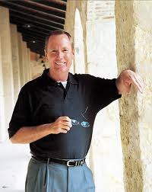

CHURCHES THAT HAVE DRIFTED AWAY
Oak hills church in San Antonio, TX (Max Lucado)
The hills church of Christ in Richland Hills, TX (Rick Atchley)
Many more churches
are following their
pattern

Slide 6
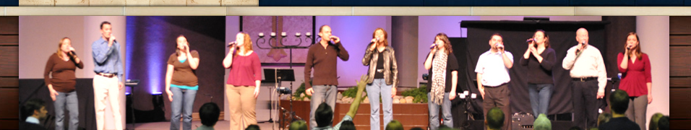
Notice what the Hills church is saying
Music
The Hills Church worship team is always looking for talented musicians and vocalists who are looking for a place to serve. Music at The Hills Church is a huge part of our worship experience and our desire is to connect people who share the same passion. If you are interested in volunteering within music at The Hills Church please contact us.

Slide 7
The Hills church
Worship Choir
The worship choir is the choral community at The Hills Church. We are always looking for more people to join us as we lead God’s people to worship Him in spirit and in truth. No audition required. We meet every Wednesday at 7:00 p.m. in room 214. If you are interested in joining the worship choir, please contact us.

Slide 8
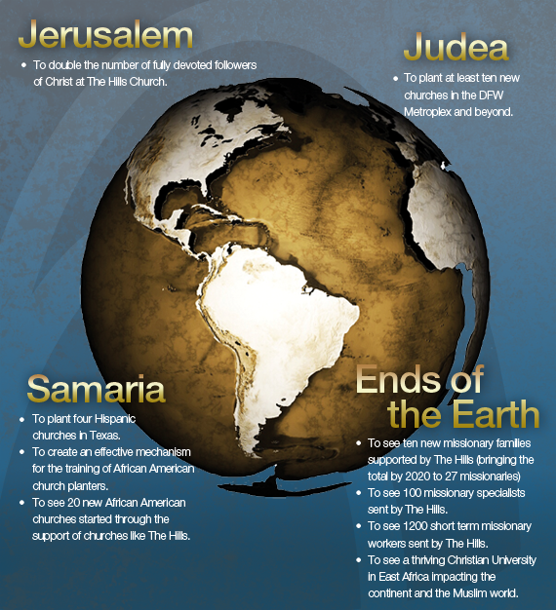
TAKING THEIR FALSE DOCTRINE TO
THE ENTIRE WORLD

Slide 9

Scriptures concerning the kind of music God desires in the New Testament: Singing

Slide 10
MATTHEW 26:30, NKJV
“And when they had sung a HYMN, they went out to the Mount of Olives”
Notice that there is NO mention of a mechanical instrument here!

Slide 11
I CORINTHIANS 14:15, NKJV
“What is the conclusion then? I will pray with the spirit, and I will also pray with the understanding. I will sing with the spirit, and I will also sing with the understanding”

Slide 12
ACTS 16:25, NKJV
“But at midnight Paul and Silas were praying and singing hymns to God, and the prisoners were listening to them”

Slide 13
EPHESIANS 5:19, NKJV
“Speaking to one another in psalms and hymns and spiritual songs, singing and making melody in your heart to the Lord”

Slide 14
COLOSSIANS 3:16, NKJV
“Let the word of Christ dwell in you richly in all wisdom, teaching and admonishing one another in psalms and hymns and spiritual songs, singing with grace in your hearts to the Lord”

Slide 15
ROMANS 15:9, NKJV
“And that the Gentiles might glorify God for His mercy, as it is written: ‘For this reason I will confess to You among the Gentiles, and sing to Your name”

Slide 16
As we can see, the kind of music God desires is singing without the use of instruments

Slide 17

Denominational leaders opposed the use of mechanical instruments in their worship

Slide 18
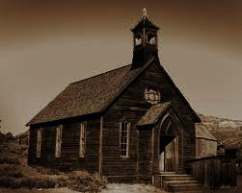
THE CATHOLIC ENCYCLOPEDIA
The voice of Catholicism: “…The first Christians were of too spiritual fiber to substitute lifeless instruments for, or to use them to accompany, the human voice”

Slide 19
THE VOICE OF THE GREEK ORTHODOX CHURCH
“The execution of Byzantine church music by instruments, or even the accompaniment of sacred chanting by instruments, was ruled out by the Eastern Fathers as being incompatible with the pure, solemn, spiritual character of the religion of Christ”
(Constantine Cavarnos, Byzantine Sacred Music).

Slide 20
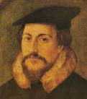
JOHN CALVIN
“Musical instruments in celebrating the praises of God would be no more suitable than the burning of incense, the lighting up of lamps, or the restoration of the other shadows of the law. The Papists, therefore, have foolishly borrowed this, as well as many other things, from the Jews.

Slide 21
JOHN CALVIN
Men who are fond of outward pomp may delight in that noise; but the simplicity which God recommends to us by the apostles is far more pleasing to Him”
(Commentary on the Book of Psalms, Vol. 1, p. 539).

Slide 22
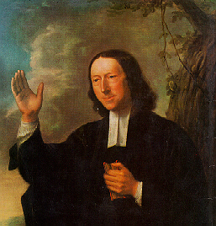
JOHN WESLEY
“I have no objection to instruments of music, in our chapels, provided they are neither heard nor seen”
(Founder of the Methodist Church)

Slide 23
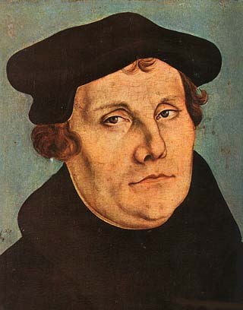
MARTIN LUTHER
He called the organ an “A sign of Baal”
(McClintock and Strong’s Cyclopedia). Luther was the founder of the Lutheran movement

Slide 24

CHARLES SPURGEON
Charles Spurgeon, Baptist Author/Pastor: "We might as well pray by machinery as sing by it" and "Israel was at school, and used childish things to help her learn; but in these days when Jesus gives us spiritual food, one can make melody without strings and pipes... we do not need them. That would hinder rather than help our praise. Sing unto Him. This is the sweetest and best music. No instrument like the human voice." Charles Spurgeon, Commentary on Psalm 42

Slide 25
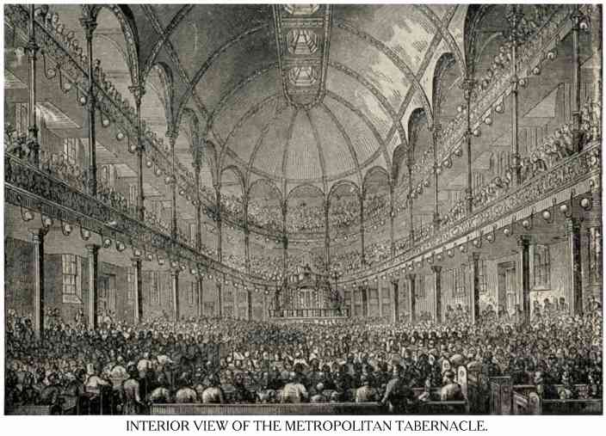

Slide 26
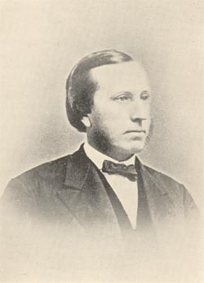
JOHN GIRARDEAU
“The church, although lapsing more and more into defection from the truth and into a corruption of apostolic practice, had no instrumental music for 1200 years (that is, it was not in general use until that time).”
Presbyterian professor at Columbia Theological Seminary, in Music in the Church, p. 179)

Slide 27
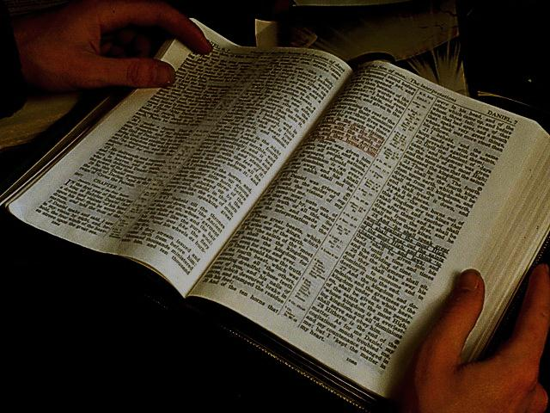
We want to clarify that these religious persons are not our authority in religion. In other words, churches of Christ do not use mechanical instruments in worship, not because these men said not to use them, but because we have no authority for it from the New Testament.

Slide 28

Reasons why the New Testament church does not use mechanical instruments in worship to God

Slide 29
THE PRINCIPLE OF AUTHORITY

Slide 30
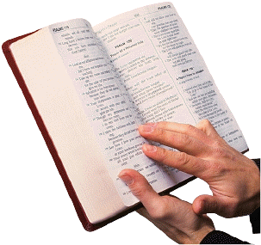
Colossians 3:17
“And whatever you do in word or deed, do all in the name of the Lord Jesus, giving thanks to God the Father through Him”
(NKJV)

Slide 31
WE HAVE BIBLE AUTHORITY FOR WHAT WE DO
For the Lord’s Supper (Acts 2:42; 1 Corinthians 11:23-26; Acts 20:7)
For preaching the Word (Mark 16:15; 2 Timothy 4:2)
For praying to God (John 14:13-14; 1 Timothy 2:8)
For the establishing of elders (1 Timothy 3:1-7; Acts 14:23; Titus 1:5-9)
For singing (Ephesians 5:19; Colossians 3:16)
THERE WAS AUTHORITY FOR INSTRUMENTS UNDER THE OLD TESTAMENT, BUT THERE IS NO AUTHORITY UNDER THE NEW TESTAMENT

Slide 32
There is no Bible authority for the use of mechanical instruments in the worship of the New Testament church

Slide 33
THE PATTERN PRINCIPLE

Slide 34
2 Timothy 1:13
“Hold fast the pattern of sound words which you have heard from me, in faith and love which are in Christ Jesus”
NKJV

Slide 35

WE HAVE A PATTERN TO FOLLOW
Concerning worship
Concerning the plan of salvation
Concerning the organization of the church
Concerning the work of the church
Concerning the mission of the church
Etc.
There is NO pattern for mechanical instruments in the worship of the N.T. church

Slide 36
We do not have a pattern to follow concerning the use of mechanical instruments by Jesus, the Apostles, or the early Christians. If we had a pattern in them, then, we would use them; but we don’t!

Slide 37
THE RESTORATION PRINCIPLE

Slide 38
1 Timothy 4:1
There was a falling away from the truth

Slide 39
The faithful churches of Christ only follow what the Bible says, not what men says.
1 Pedro 4:11; Titus 2:1; 2 Timoty 1:13

Slide 40

We must Go
Back to the Bible

Slide 41

We can restore…
The plan of salvation
The organization of the church
The worship of the church
Etc.

Slide 42
We cannot restore
Mechanical instruments
Because they were never
Used by the N.T. church

Slide 43
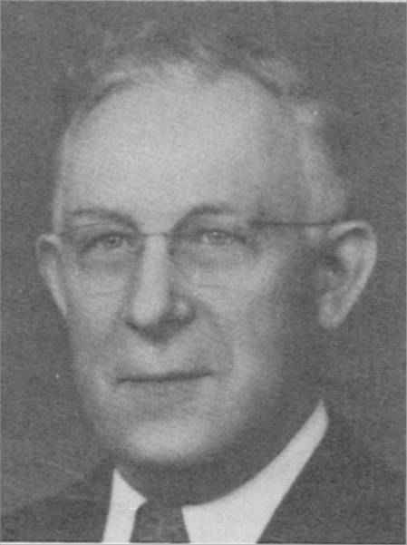
G.C. Brewer once said:
How can you restore something that is not there?
Grover Cleveland Brewer
1884-1956

Slide 44
ADDITIONAL ARGUMENTS USED TO JUSTIFY THE USE OF MECHANICAL INSTRUMENTS IN WORSHIP

Slide 45
The N.T. does mention instruments in Luke 15:25
This passage of Scripture is not authorizing the use of mechanical instruments in worship. This is not a worship scenario. This is just a party that was going on for the return home of the prodigal son.

Slide 46
Revelation mentions instruments
The book of Revelation is a highly symbolic book.
Most of the things mentioned in Revelation represent something:
“Now when He had taken the scroll, the four living creatures and the twenty-four elders fell down before the Lamb, each having a harp, and golden bowls full of incense, which are the prayers of the saints” (Revelation 5:8)

Slide 47
"There will be mechanical music in heaven." Revelation 14: 2 is quoted to prove there will be mechanical music in the worship of God in heaven. It reads, "And I heard a voice from heaven, as the voice of many waters, and as the voice of a great thunder: and I heard the voice of harpers harping with their harps." I believe it is apparent that John is not saying that the voice he heard was many waters, thunder, or harpers harping with their harps. The voice was as…. The American Standard Version attempts to convey this analogy to the reader. They render the verse, "And I heard a voice from heaven, as the voice of many waters, and as the voice of a great thunder: and the voice which I heard was as the voice of harpers harping with their harps."

Slide 48
"Harps" in Revelation are symbolic for praise, just as golden vials full of odors are symbolic of prayer (Rev. 5: 8). Besides, it is certain that no material thing will be in heaven. We must remember that mechanical music as used under the Jewish system was not sinful within itself. As a type, though, the antitype replaced it. We are to pluck the strings of the human heart. We should not, then, imagine that the type, mechanical music, will be in heaven no more than the typical burning of incense will be restored.
http://www.bibletruths.net/archives/BTAR119.htm

Slide 49
Ephesians 5:19 includes instruments
Some argue that the word “making melody” from the Greek, “PSALLO” includes the use of mechanical instruments. Thayer’s Greek Lexicon is used to justify this conclusion:

Slide 50
Thayer's Greek Lexicon
ψάλλω
psallō
Thayer Definition:
1) to pluck off, pull out
2) to cause to vibrate by touching, to twang
2a) to touch or strike the chord, to twang the strings of a musical instrument so that they gently vibrate
2b) to play on a stringed instrument, to play, the harp, etc.
2c) to sing to the music of the harp

Slide 51
Thayer’s Greek Lexicon
Full Definition
ψάλλω
Thayer Definition:
1) to pluck off, pull out
2) to cause to vibrate by touching, to twang
2a) to touch or strike the chord, to twang the strings of a musical instrument so that they gently vibrate
2b) to play on a stringed instrument, to play, the harp, etc.
2c) to sing to the music of the harp
2d) in the NT to sing a hymn, to celebrate the praises of God in song

Slide 52
Ephesians 5:19
“Speaking to one another in psalms and hymns and spiritual songs, singing and making melody in your heart to the Lord”
The instrument is the heart!

Slide 53
The question is not HOW to worship, but WHO to worship

Slide 54
There are serious consequences when we do not follow what the Bible teaches

Slide 55
EXAMPLES WORTH CONSIDERING
Nadab & Abihu
Leviticus 10:1-3
“Then Nadab and Abihu, the sons of Aaron, each took his censer and put fire in it, put incense on it, and offered profane fire before the Lord, which He had not commanded them. So fire went out from the Lord and devoured them, and they died before the Lord”

Slide 56
EXAMPLES WORTH CONSIDERING
Uzza
1 Chronicles 13:9-10
“And when they came to Chidon’s threshing floor, Uzza put out his hand to hold the ark, for the oxen stumbled. Then the anger of the Lord was aroused against Uzza, and He struck him because he put his hand to the ark; and he died there before God”

Slide 57
Friends, God does care HOW we worship Him!

Slide 58
What is our responsibility concerning this lesson?

Slide 59
We must share what we have learned
We must continue to study the Word of God
We must be ready to give an answer at all times
We must give diligence to our faithfulness so that we will not depart from the truth
We must respect the authority of the Scriptures

Slide 60
May God continue to help us as we strive to do His will

Slide 61
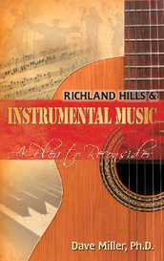
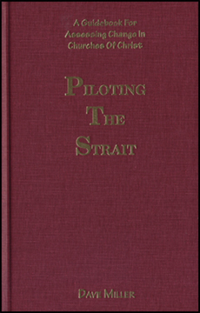
Recommended books for young people to read

