Slide 1
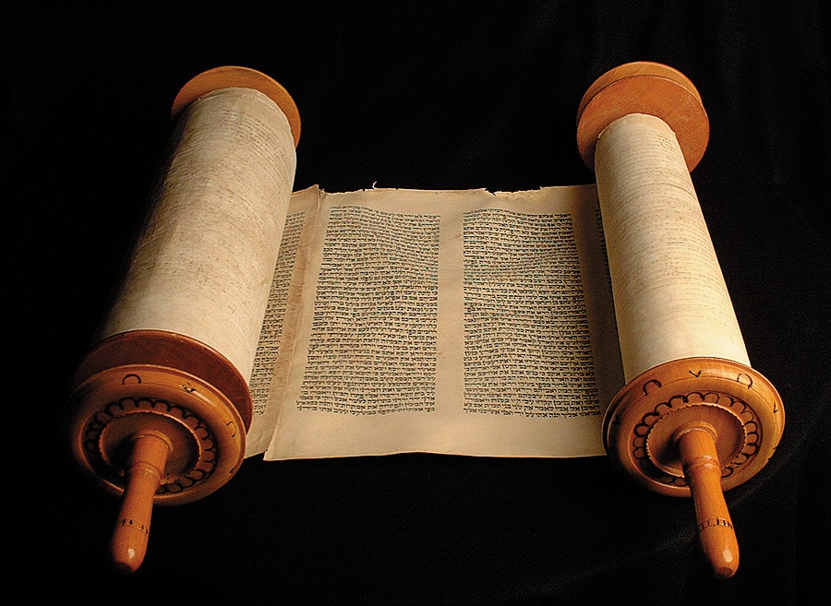
  HISTORY OF MUSIC AND ITS FUNCTION IN THE OLD TESTAMENT
  Willie Alvarenga

Slide 2
Overview of our lesson
A call to search the Scriptures
Why these series of lessons are important
What this lesson is not entirely about
The use of music under the Old Testament
Arguments in favor of mechanical instruments taken from the Old Testament
Refutation to this arguments
Our responsibility before us

Slide 3


A CALL TO SEARCH THE SCRIPTURES:
Acts 17:11
1 Thessalonians 5:21
1 John 4:1

Slide 4
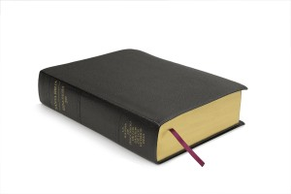
A CALL TO BE DOERS OF GOD’S WORD:
James 1:22
Luke 11:28
Luke 9:44

Slide 5
Why these lesson are important
  They deal with a topic the Bible speaks about
  They deal with a big problem the church of the New Testament is facing today
  Many people are not familiar with this topic. Fundamental subjects of the Bible

Slide 6
Why these lesson are important
  Many people have been taught incorrectly about the kind of music God desires today
  They deal with the issue of authority for practices during the worship of the N.T. church
  A misunderstanding of this subject can lead someone in the path of eternal destruction

Slide 7

What this lesson is not entirely about

Slide 8
  We will not do an in-depth study of mechanical instruments of music under the Old Testament.
  We will not spend too much time on information which will not be helpful to those important things we need to know today (Authority & Acceptable worship).
  We need to focus on what really matters here.

Slide 9

The use of music under the Old Testament period
The use of music & its function under the Old Testament period

Slide 10
What does the Bible say about music & its function under the Old Testament period?

Slide 11
The first reference to mechanical instruments goes back to Genesis 4:20, where Jubal is mentioned as the father of all who play the harp and flute. Jubal was a descendant of Cain.
God was worshipped with mechanical instruments under the Old Testament period (Psalm 33:1-5; Psalm 150)
God “commanded” the use of instruments under the Old Testament period (2 Chronicles 29:25-28; Psalm 81:1-4)

Slide 12
When the people of God were rebellious and given to sin; God did not accept their worship with mechanical instruments (Amos 5:21-23)
Instruments were also used to greet family that came home. Jephtah’s daughter used instruments of music to run to greet her father (Judges 11:34)
Joshua used trumpets of ram’s horns to bring down the walls of Jericho (Joshua 6:4)

Slide 13
Saul was welcomed home from the battle of the Philistines by the women shouting and playing on instruments of music (1 Samuel 18:6)
As we can see, instruments of music were used for different purposes under the Old Testament period.

Slide 14
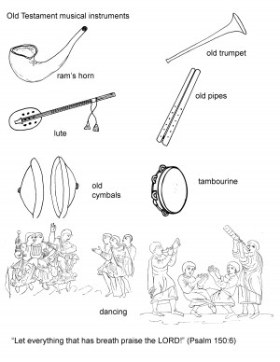

Slide 15
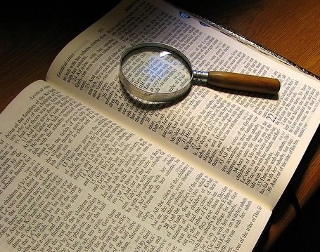
One thing we MUST understand is that just because mechanical instruments were used under the Old Testament period DOES NOT mean or imply that they can be used under the New Testament worship of the church.

Slide 16
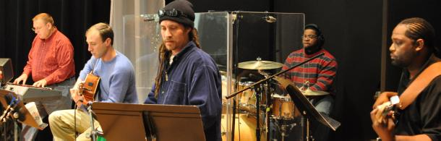
Unscriptural Arguments people use from the Old Testament to justify the use of mechanical instruments today

Slide 17

Please pay close attention for you will have to answer these arguments sooner or later

Slide 18
2 Chronicles 29:25-28; Psalm 33:1-5; Malachi 3:6
God commanded the use of mechanical instruments under the Old Testament worship and therefore, we must use them today

Slide 19
    God also commanded the following to be observed under the Old Law:
    Animal sacrifices (Psalm 51:19; Exodus 20:24)
    The killing of rebellious sons (Deuteronomy 21:18-21)
    The killing of people committing adultery (Deuteronomy 22:22)
    Keeping the Sabbath holy (Exodus 20:11)

Slide 20
We are not under the Old Testament Law
Colossians 2:14
Ephesians 2:14-15
Hebrews 8:13
Galatians 3:10
Romans 7:1-25
Jeremiah 31:31-34

Slide 21
Psalms is not part of the law and therefore, instruments were not done away
The following passages prove that Psalms is part of the Law:
John 10:34 (Psalm 82:6)
John 12:34 (Psalm 89:4)
John 15:25 (Psalm 69:4)

Slide 22
One must not resurrect any Old Testament practice in an attempt to justify worship conduct under the New Covenant regime. If the use of instrumental music in Christian worship is to be sanctioned, there must be New Testament authority for such. And the reality is, there is none — a fact which some advocates of instrumental music now concede. A current ploy is that “authority” is an irrelevant issue. This is a disastrous conclusion of last resort.
Wayne Jackson, Do the Psalms Authorize Instrumental Music in Worship?

Slide 23
Passage out of context: Revelation 22:18-19
If we don’t use mechanical instruments, we are taking away from God’s Word

Slide 24
ANOTHER ARGUMENT:
  David was a man after God’s own heart, and his worship with instruments was acceptable to God; and so is ours when we use instruments to worship Him
  Acts 13:22

Slide 25
If David is the Christian’s pattern for acceptable worship in this age, why not worship God by the offering of animal sacrifices — as Israel’s illustrious king did (Psa. 66:13-15)? Or perhaps a Christian worship assembly could be transformed into a “dance” festival, reminiscent of the shepherd’s activities (2 Sam. 6:14; Psa. 149:3).
And if the “David-was-a-good-man” argument justifies doing anything the king did, would polygamy be justified today? David had many wives (2 Sam. 5:13), from whom he was never commanded to separate. Some Mormon sects would applaud the “David-was-a-good-man” argument!
Wayne Jackson, Responding to Critics on “Instrumental Music” issue.

Slide 26
ANOTHER ARGUMENT:
  There is no passage in the Bible that says that we cannot use mechanical instruments when we worship God

Slide 27
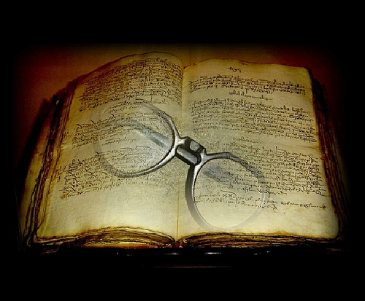
We must RESPECT the SILENCE of the Scriptures

Slide 28
WE DON’T NEED A PASSAGE THAT SAYS “DON’T USE THEM”
Can we use Coke and Pizza instead of grape juice and unleavened bread for the Lord’s Supper?
Can we sacrifice animals during our worship services?
Can we go outside of the church building during our lunch break and smoke a cigarette?
How would you feel if you went to the pizza place and order a pepperoni and cheese pizza, but the man at the store put anchovies, bell peppers, and much more of which you are allergic to?

Slide 29
WE MUST REASON CORRECTLY
God has specified the kind of music He desires under the New Testament
Ephesians 5:19 & Colossians 3:16
Authorize SINGING

Slide 30
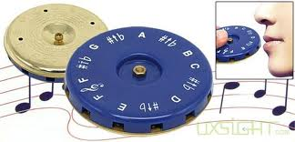
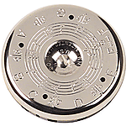
ANOTHER ARGUMENT
If we can use a Pitch Pipe, then we can use an instrument when we sing to God

Slide 31
Let us reason correctly
One person said:
The difference between a pitch pipe and a mechanical instrument is that the pitch pipe knows enough to stay quiet when worship begins, and the mechanical instrument doesn’t

Slide 32
More on our second lesson
We will consider more arguments and the explanation of the word “Psallo” in Ephesians 5:19 on our second lesson

Slide 33
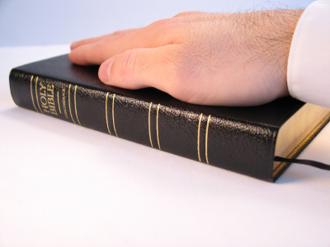
What is our responsibility as Christians concerning this topic?

Slide 34
We all have friends and family members who probably belong to denominations that use mechanical instruments

Slide 35
OUR RESPONSIBILITY
We must reason correctly from the Scriptures so that we will not miss-interpret the Word of God (2 Timothy 2:15). We have lost people to denominations.
We must grow in knowledge so that we can guide people out of error (2 Peter 3:18).
We must always be ready to give an answer (1 Peter 3:15).

Slide 36
OUR RESPONSIBILITY
We must learn to worship our heavenly Father acceptably (John 4:23-24)
We must not go beyond what has been written (1 Corinthians 4:6; 2 John 9-11)
We must only practice that which has been authorized by the Scriptures (Colossians 3:17)

Slide 37
REVIEW OF OUR LESSON:
We have considered the use of mechanical instruments under the Old Testament
Arguments used in favor of mechanical instruments
Our responsibility concerning this topic

Slide 38
May God help us to practice only that which He authorizes!
I encourage you to stick around for the second part of this lesson

