Slide 1


Slide 2
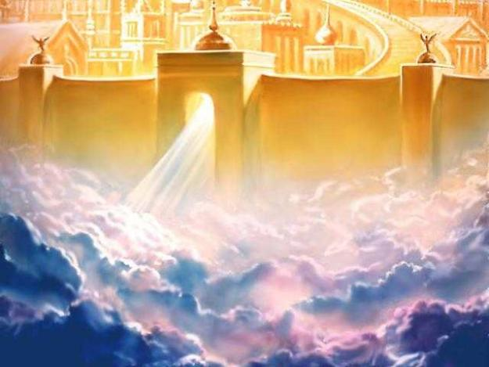
How Beautiful Heaven Must Be!
By
Willie Alvarenga

Slide 3

Overview of our lesson
The reality of Heaven
Why Heaven is a beautiful place
How people can get to Heaven

Slide 4


Consider the following passages
Acts 17:11
John 7:17
James 1:22

Slide 5

A SAD REALITY
Not many people want to be in heaven
Many Christians do not think about heaven anymore

Slide 6

Let us consider the reality of Heaven According to the Bible

Slide 7
The Bible Teaches That Heaven Is A Real Place!
God’s Word
Is True!
2 Timothy 3:16-17
2 Peter 1:20-21
John 14:1-3
Philippians 3:20
2 Corinthians 5:1-2
Matthew 7:21
Colossians 1:5
Matthew 6:20
Matthew 5:12
2 Timothy 4:18

Slide 8

Questions for our consideration
Do we truly believe all of these passages?
Are we really living our lives in view of the reality of Heaven?
Are we anxiously awaiting Heaven?

Slide 9
Let us consider WHY Heaven is a BEAUTIFUL place

Slide 10
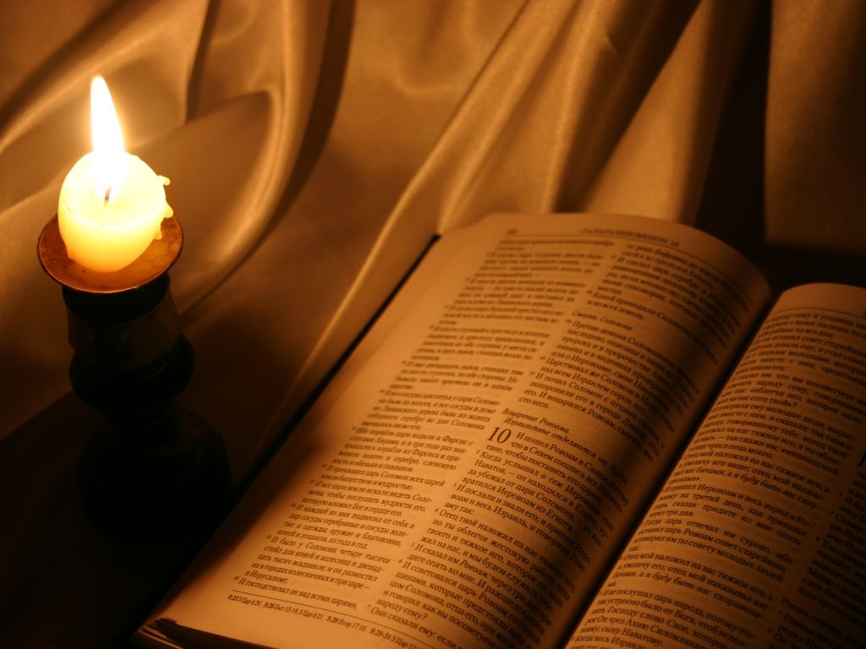
Why is Heaven a Beautiful Place?

Slide 11
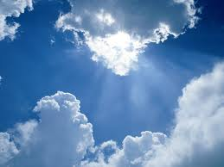
God, Jesus and the angels will be there
Heaven is a place of rest and peace (Rev. 21:4)
Heaven is a place where there is no sin (Rev. 21:27)
Heaven is not eternal punishment
Heaven is a place of reunion

Slide 12
Let us consider what people must do in order to spend eternity in Heaven

Slide 13
There is a misunderstanding in the world about who will be in heaven
Many believe that in the end, God will save everyone, no matter who you are, or what you believe.

Slide 14
Something you must understand
1 Timothy 2:4
Titus 2:11
2 Peter 3:9
John 3:16
Mark 16:15-16
Ezekiel 33:11
God wants you to be in heaven

Slide 15
Notice who will be in heaven
Those who do the will of God (Matthew 7:21; Hebrews 5:8-9)
Those who obey the gospel of Christ (Romans 1:16; Mark 16:16; 2 Thessalonians 1:7-9)
Those who live faithful lives in Christ (Revelation 2:10; 3:5)

Slide 16

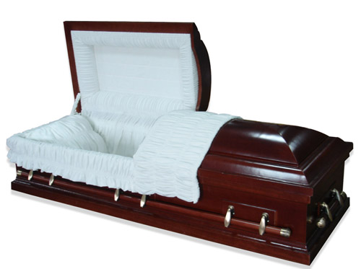
This may be your last day
The Bible teaches that we will all die some day (Hebrews 9:27; James 4:14; I Samuel 20:3; 2 Samuel 14:14)
Are you ready?

Slide 17


Christ may come today!
Matthew 24:36
Matthew 24:44
1 Thessalonians 5:1-2
Are You Ready?

Slide 18

There is something you MUST do in order to be in heaven!
You must hear the gospel (Rom. 1:16; 1 Cor. 15:1-4; Rom. 10:17; Acts 18:8)
You must believe the gospel (Mk. 16:15-16; Acts 18:8)
You must repent of your sins (Acts 2:38; 17:30)
You must confess Christ as the Son of God (Rom. 10:9-10)
You must be baptized into Christ (Acts 2:38, 41; Gal. 3:27; Mark 16:16)
You must live a faithful life in Christ (Rev. 2:10
You
Must
Obey
The
Gospel

Slide 19
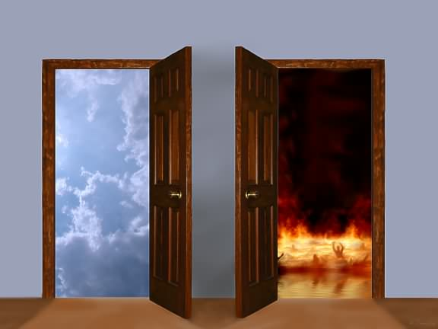
YOU ONLY HAVE TWO OPTIONS

