Slide 1
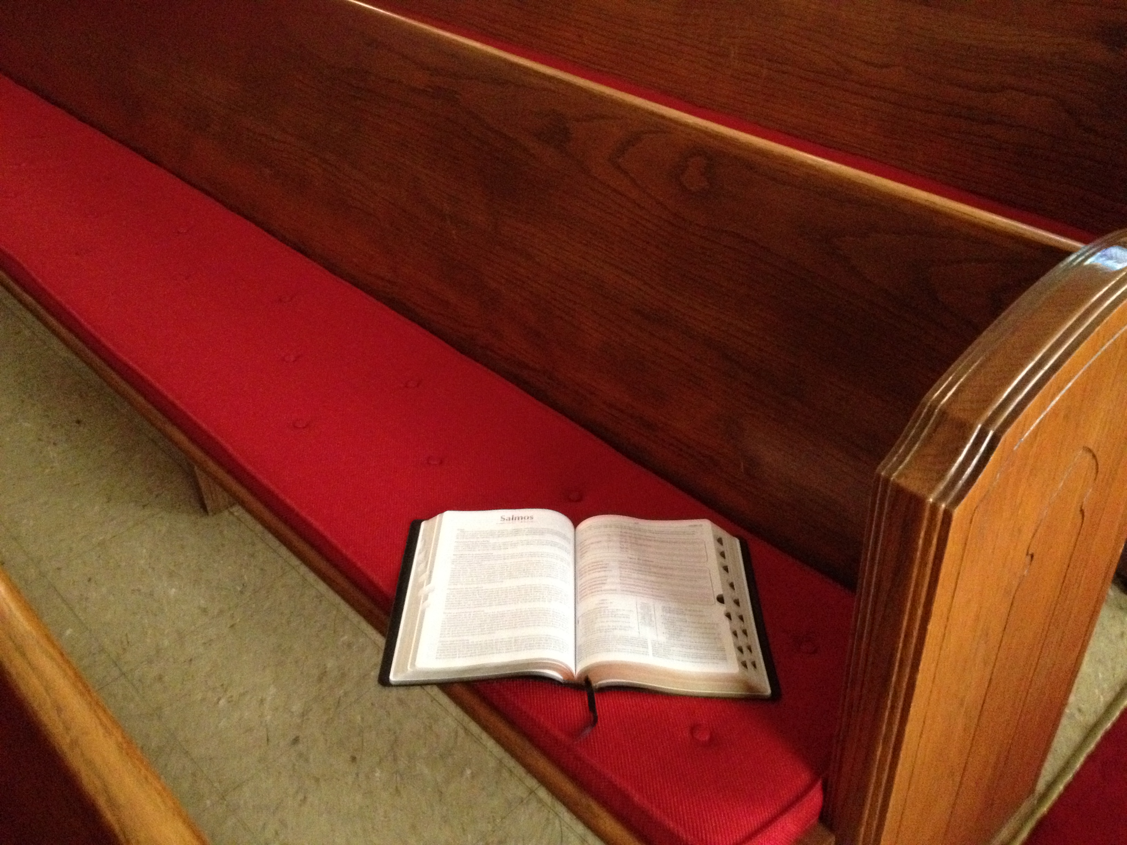
Is the Bible Inspired?
2 Timothy 3:16-17
by Willie Alvarenga

Slide 2
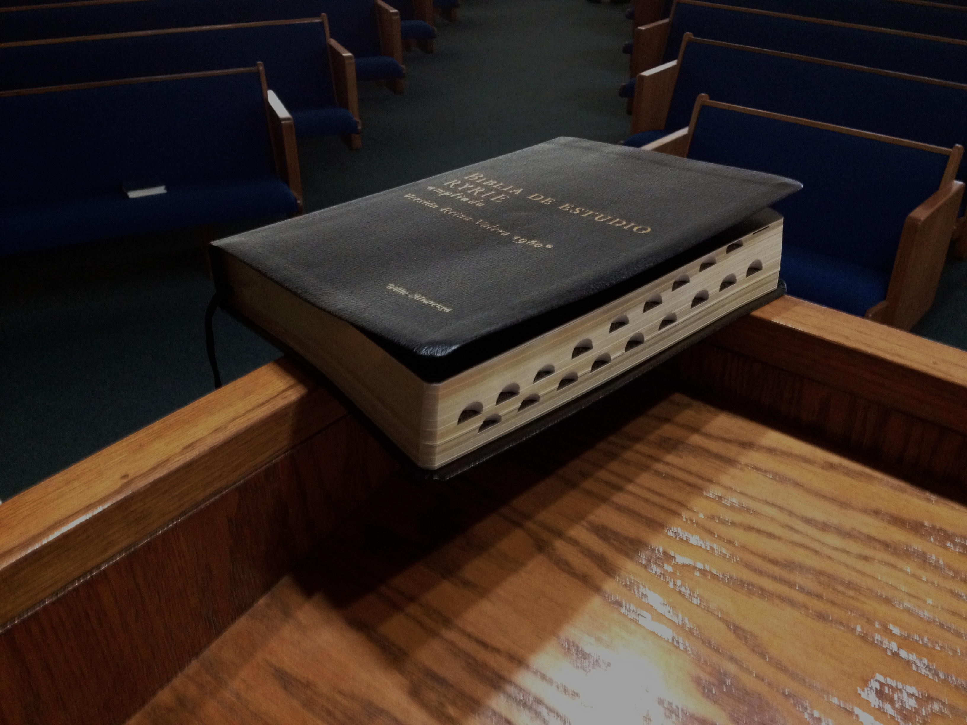
Overview of our lesson
A call to search the Scriptures
An analysis of our passage under consideration
Reasons why the Bible is inspired of God
Our attitude towards the Scriptures

Slide 3
Please search the Scriptures!
Acts 17:11
1 Thessalonians 5:21
1 John 4:1

Slide 4
Why is this a very important subject?
It deals with a life and death matter.
It is a biblical one.
It is one that will strengthen our faith.
It is one that will help us to be always ready to teach others.

Slide 5

A brief analysis
of 2 Timothy 3:16-17

Slide 6
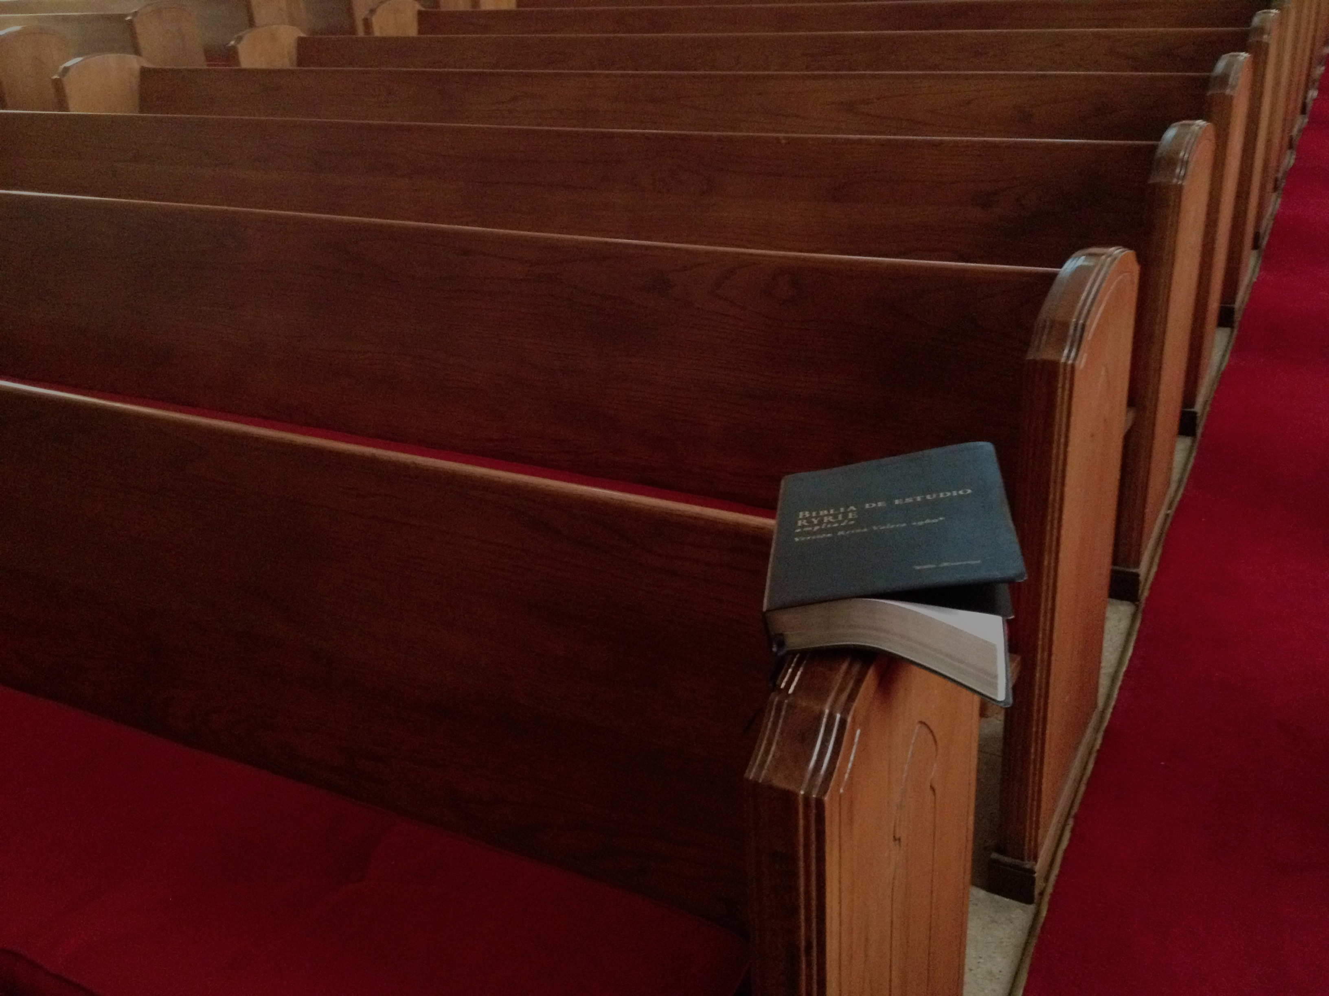
The Central Theme of 2 Timothy
Holding the pattern of sounds words
(2 Timothy 1:13)

Slide 7
Holding the Pattern of Sound Words
By not being ashamed of the testimony of Jesus (1:8-12).
By being loyal to the faith (1:13-18).
By being strong in the grace which is in Christ Jesus (2:1-13).
By presenting ourselves approved unto God (2:14-18).
By living a holy life in Christ (2:19-26).

Slide 8
Holding the Pattern of Sound Words
By continuing in the things which we have learned (3:10-15).
By acknowledging the Inspiration and the power of the Bible (3:16-17).
By preaching the Word of God (4:1-5).
By keeping faithful even to the end (4:6-18).

Slide 9
One of the ways how we can hold the pattern of sound words is by acknowledging the inspiration of the Bible
(2 Timothy 3:16-17)

Slide 10
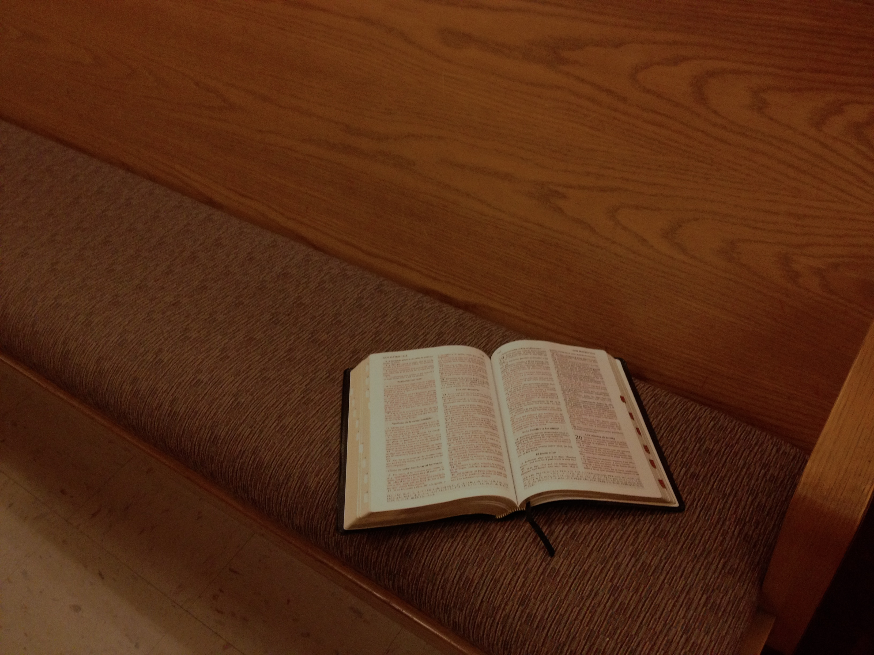
2 Timothy 3:16-17 establishes the totality of the inspiration of God’s Word

Slide 11
“Inspired of God”
Wayne Jackson said the following concerning this phrase:
“Inspired of God” is a single term in the Greek, theopneustos, “God-breathed.” The language is metaphorical, in the sense that, “God breathed his message into the minds of the sacred writers,” while allowing individual vocabulary styles to prevail.

Slide 12
“Inspired of God”
The word expresses the action of the Holy Spirit in “bearing along” men who spoke/wrote under divine guidance (cf. 2 Peter 1:21).
Jackson, Wayne, Paul’s Letter to Timothy and Titus, Before I Die (Stockton, CA: Christian Courier Publications, 2007), pages 71-72

Slide 13
Inspiration in the Old & New Testament

Slide 14
Inspiration in the Old Testament
Old Testament
Exodus 20:1
“And God spoke all these words, saying” (NKJB)
Exodus 32:16
“Now the tablets were the work of God, and the writing was the writing of God engraved on the tablets” (NKJB)

Slide 15
Inspiration in the Old Testament
Old Testament
2 Samuel 23:2
“The Spirit of the Lord spoke by me, and His Word was on my tongue” (NKJB)
Psalm 19:7
“The law of the Lord is perfect, converting the soul; the testimonty of the Lord is sure, making wise the simple” (NKJB)

Slide 16
Inspiration in the New Testament
New Testament
2 Timothy 3:16
“Every Scripture inspired of God is also profitable for teaching, for reproof, for correction, for instruction which is in righteousness” (ASV 1901)
2 Peter 1:20-21
“Knowing this first, that no prophecy of scripture is of private interpretation. For no prophecy ever came by the will of man: but men spake from God, being moved by the Holy Spirit” (ASV 1901)

Slide 17
Inspiration in the New Testament
New Testament
1 Corinthians 2:13
“These things we also speak, not in words which man’s wisdom teaches but which the Holy Spirit teaches, comparing spiritual things with spiritual” (NKJB)
1 Thessalonians 1:5
“For our gospel did not come to you in word only, but also in power, and in the Holy Spirit and in much assurance, as you know what kind of men we were amoung you for your sake” (NKJB)

Slide 18
Claims of Inspiration Make the Bible Unique
The Bible is super human in teaching and structure. “God spake” or “Thus saith the Lord” is used 1,300 times in the prophets and 2,500 times in the Old Testament alone.”
Looney, David, The Uniqueness of the Bible As Proof of Inspiration, The Inspiration of the Bible, Spiritual Sword Lectures, 1996, p. 37.

Slide 19
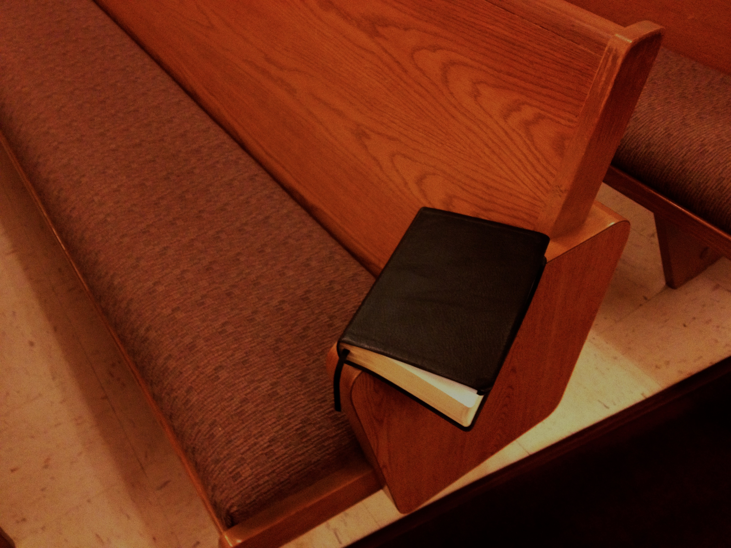
Let us consider some reasons why the Bible is inspired of God

Slide 20
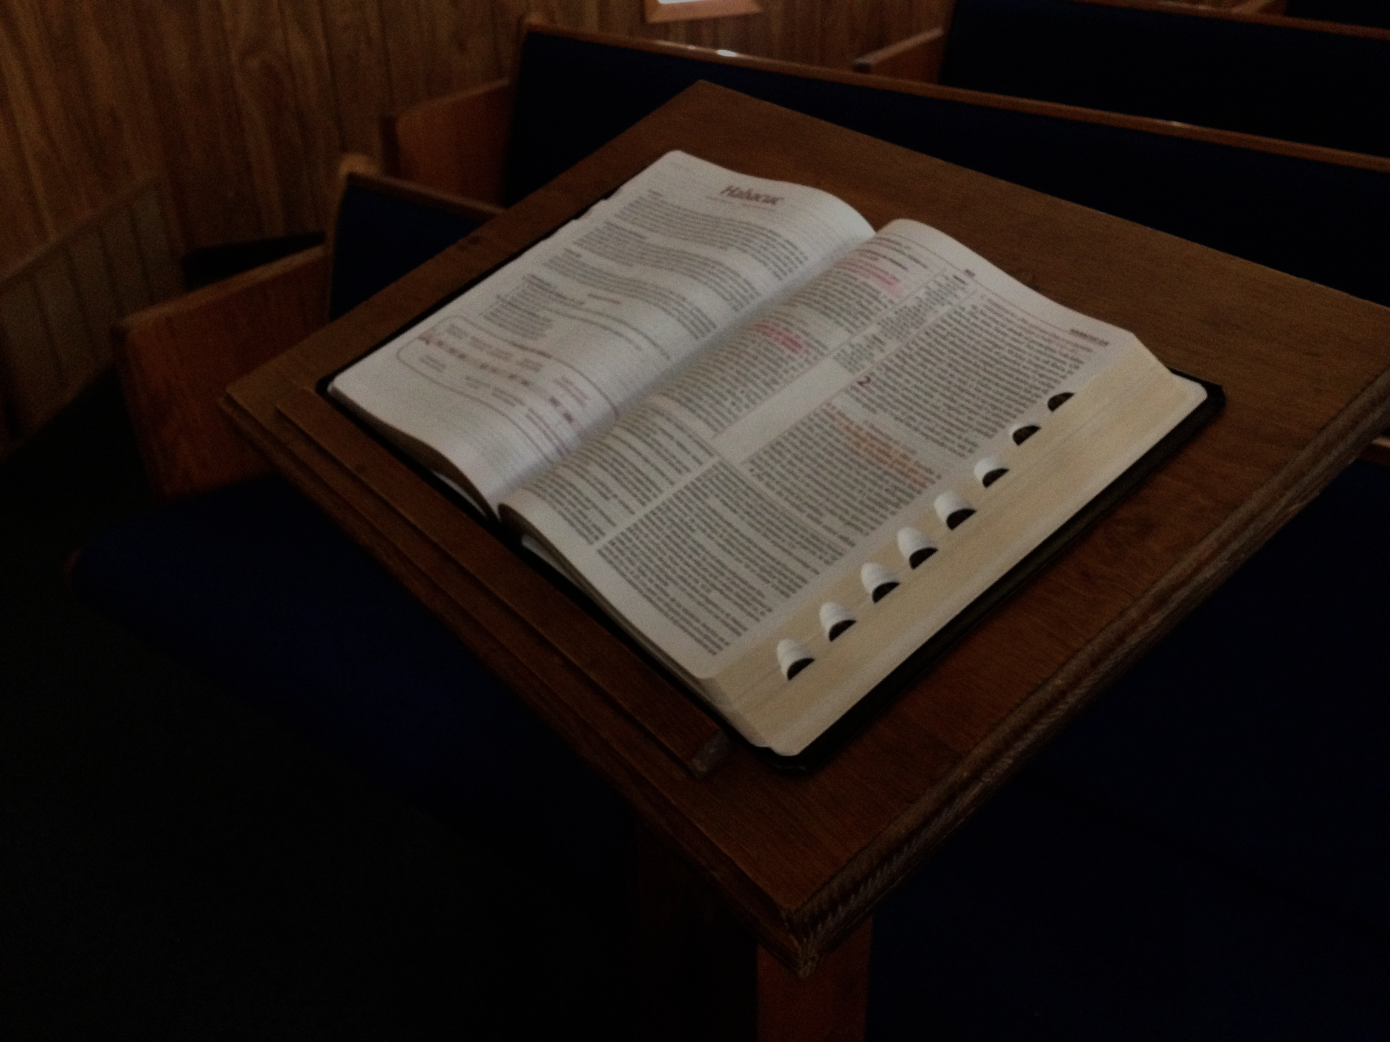
# 1
The indestructibility of the Bible proves its inspiration

Slide 21
King Jehoiakim (Jeremiah 36) tried to destroy the Word of God, but to no avail. This man has been utterly forgotten, while the Bible continues on!

Slide 22
Diocletian, emperor of Rome (4th century). This emperor took pleasure in the burning of every copy of the Scriptures he could get his hands on. This man claimed to have exterminated the Christian writings from the face of the earth. He even erected a monument over the ashes of burned Bibles with the inscription: Extincto Nomine Christianorum– “Extinct is the name of Christians.” (Goodpasture, p. 13).

Slide 23
Another emperor named, Constantine, dedicated himself to put the New Testament in all of the churches of his empire. He offered a sizable reward to anyone who would deliver a copy of the Scriptures to him. Within twenty-five hours, Constantine was offered fifty copies of the Word of God (Winkler, The Case for Christianity, p. 167).

Slide 24
The French infidel Voltaire (1694-1778), declared, “One hundred years from my day there will not be a Bible in the earth, except one that is looked upon by an antiquarian curiosity seeker” (Dunn, Frnak J., The Holy Scriptures:
The Second Annual “Fort Worth” Lectures, ED. Wendell Winkler, p. 49).

Slide 25
Jesus said:
“Heaven and earth shall pass away, but my words shall not pass away”
(Matthew 24:35; Mark 13:31 & Luke 21:23

Slide 26
Peter said:
“Having been begotten again, not of corruptible seed, but of incorruptible, through the word of God, which liveth and abideth. For all flesh is as grass, and all the glory thereof as the flower of grass. The grass withered, and the flower falleth: but the word of the Lord abideth forever. And this is the word of good tidings which was preached unto you””
(1 Peter 1:23-25)

Slide 27
# 2
The fulfillment of Bible prophecies proves the inspiration of the Bible

Slide 28
One of the most impressive internal proofs of the Bible’s inspiration is its prophetic utterances. Rex A. Turner Sr. has suggested the following:
“Predictive prophecy is the highest evidence of divine revelation. The one thing that mortal man cannot do is to know and report future events in the absence of a train of circumstances that naturally suggest certain possibilities”
Turner, Rex A. Sr., Systematic Theology (Montgomery, AL: Alabama Christian School of Religion, 1989), p. 12

Slide 29
The Old Testament contains more than three hundred messianic prophecies. As Hugo McCord has said, “Testimony about Jesus was the chief purpose of prophecy. To him all the prophets gave witness (Acts 10:43)”
McCord, Hugo, Internal Evidences of the Bible’s Inspiration,” The Holy Scriptures, ed. Wendell Winkler (Fort Worth, TX: Winkler Publications), p. 332

Slide 30
Fulfilled Prophecies
The Birth of Christ Micah 5:2 735-700 AD | Matthew 2
The Death of Christ Isaiah 53 750 AD | Matthew 27; Mark 15; Luke 23; John 19
The Establishment of the church/kingdom Isaiah 2; Daniel 2 750 AD/530 AD | Mark 9:1; Acts 2; Colossians 1:13

Slide 31
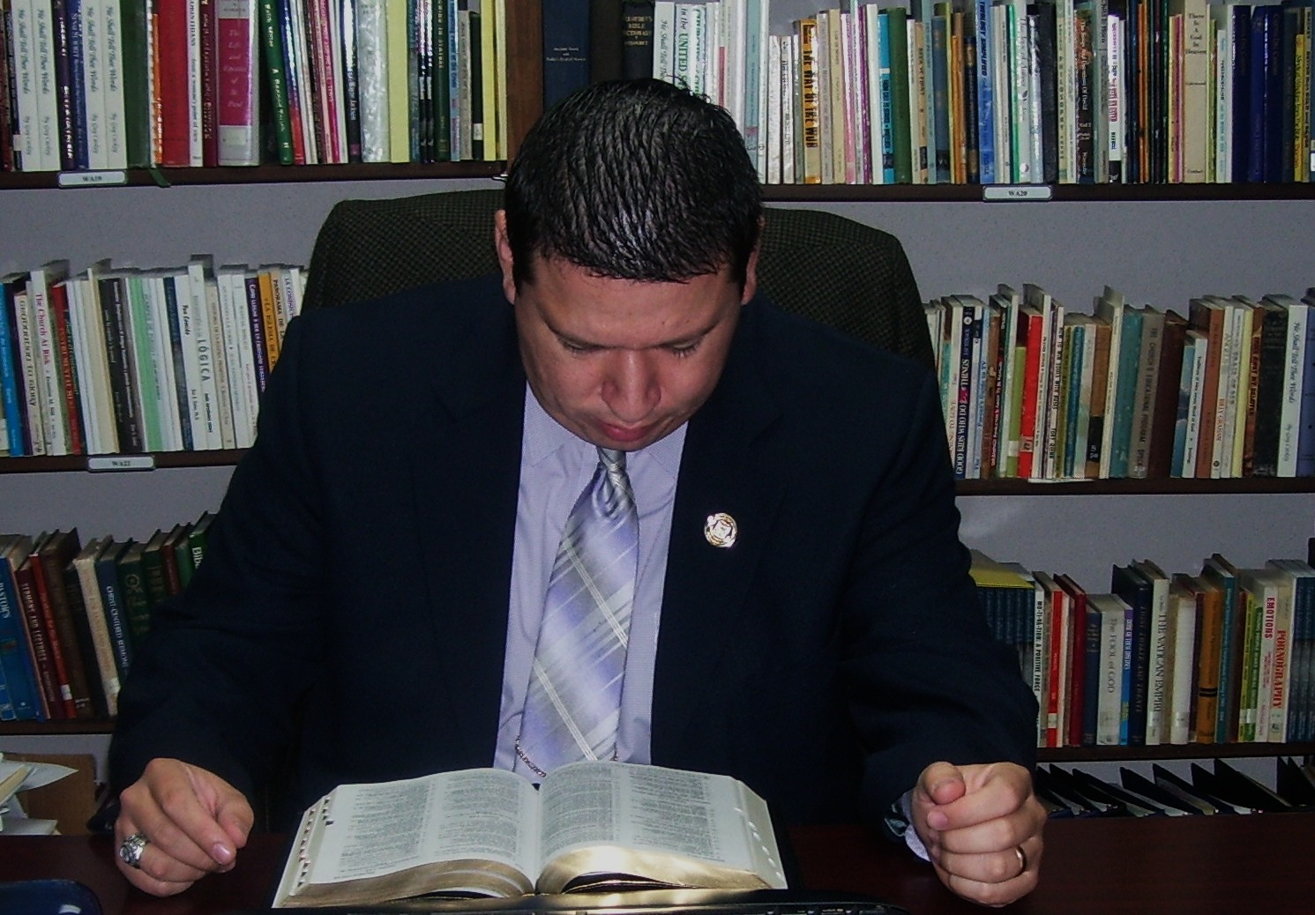
A careful study of the Gospels will reveal several passages of Scripture which are a fulfillment of prophecies made from the Old Testament!

Slide 32
Brother Jim Lewis said the following about fulfilled prophecies:
“Predictive prophecy says to both friend and foe of the Bible: ‘I claim to be from God. I claim to be of such a nature that I could not possibly be from any source other than God. I present myself openly and freely for all to investigate my claims.’”
Lewis, Jim, The Fulfillment of Predictive Prophecy As Proof of Inspiration, The Inspiration of the Bible, Spiritual Sword Lectures, 1996, p. 144

Slide 33
# 3
The power to change people’s lives proves the inspiration of the Bible

Slide 34
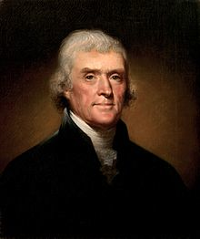
President Thomas Jefferson said, “I have always said and always will say that the studious perusal of the Sacred Volume will make better citizens, better fathers, better husbands… the Bible makes the best people in the world”
www.biblein90days.org/en/quotes/search.aspcategory=Presidents+and+Bible

Slide 35
14But abide thou in the things which thou hast learned and hast been assured of, knowing of whom thou hast learned them. 15And that from a babe thou hast known the sacred writings which are able to make thee wise unto salvation through faith which is in Christ Jesus. 16Every scripture inspired of God is also profitable for teaching, for reproof, for correction, for instruction which is in righteousness. 17That the man of God may be complete, furnished completely unto every good work.
  American Standard Version. 1995 (2 Ti 3:1417). Oak Harbor, WA: Logos Research Systems, Inc.
Since the Bible is from God, its message is so powerful that it can change people’s lives!
2 Timothy 3:14-17

Slide 36
Because of the inspired message…
Many are not given to drunkenness!
Many are not living in immorality!
Many are not given to domestic violence!
Many are not living in fornication!
Many are not living in sin any more!

Slide 37
THE INSPIRED GOSPEL OF CHRIST
The Gospel of Christ, which is IN THE BIBLE, is the only POWER of God unto salvation (Romans 1:16).
This is the only way to experience a new life in Christ (2 Corinthians 5:17; Romans 6:4)

Slide 38
The Inspired Message Has Changed Peoples’ lives
Saul of Tarsus (Acts 9, 22, 26)
Those in Corinth (1 Corinthians 6:9-11)
Those in Ephesus (Acts 19:18-20)
And many more, even to this day!

Slide 39
What should be our attitude towards the Word of God?

Slide 40

Our Attitude!
We should love the Bible (Psalm 119:97; Job 23:12).
We should grow in the knowledge of the Bible (2 Peter 3:18).
We should read the Bible (1 Timothy 4:13).
We should memorize the Bible (Psalm 119:11).
We should teach the message of the Bible to others (Mark 16:15).

Slide 41
Summary of our lesson
We have briefly considered three reasons why the Bible is the Inspired Word of God:
1. The indestructibility of the Bible.
2. The fulfilled prophecies of the Bible.
3. The power of the Bible to change lives.
Let us continue to study this very important fundamental subject!

Slide 42
The Bible Is Inspired
B.C. Goodpasture
The question of inspiration is vital. If the Bible is not of divine origin, we cannot rely upon its statements of fact; we need not bow to its claims of authority; and we cannot derive hope and comfort from its promises.

Slide 43
The Bible Is Inspired
B.C. Goodpasture
If it represents only the efforts of uninspired men, we may view its contents of little or no concern. On the other hand, if the Bible came from God, its authority is unquestionable and its statements are infallible.
B.C. Goodpasture, Free-Hardeman College Lectures, 1970—The Church Faces Liberalism, Thomas B. Warren, ed., “The Inspiration of the Bible,” (Nashville, TN: Gospel Advocate Company, 1970), p. 54

