Slide 1
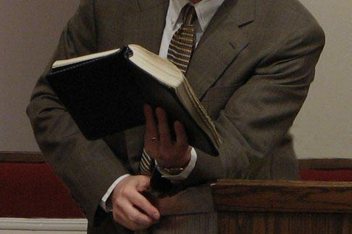
More Through Less
Matthew 5:41
“And whoever compels you to go one mile, go with him two” (NKJV)
Willie Alvarenga

Slide 2

Let me encourage you to search the Scriptures as we study this lesson!
Acts 17:11; 1 Thessalonians 5:21

Slide 3
Let me encourage you to be a doer of god’s word!
James 1:22; Luke 11:28

Slide 4
Our topic under consideration deals with a series of lessons dealing with paradoxes found within the Scriptures

Slide 5
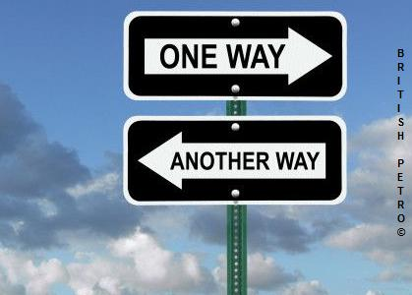
PARADOX
A tenet contrary to received opinion; also, an assertion or sentiment seemingly contradictory, or opposed to common sense, but that yet may be true in fact.
Webster’s New Collegiate Dictionary

Slide 6
MANY EXAMPLES OF PARADOXES
Galatians 1:21; 1 Thess. 4:13-16
Romans 5:3; James 1:2; Colossians 1:24; Matthew 5:10-12
Hebrews 13:5; Matthew 28:20; Acts 7; 14
Matthew 5:29-30; 1 Thessalonians 5:23; 1 Corinthians 6:19-20

Slide 7

We must acknowledge the fact that God’s Word does not have any contradictions or errors. The Bible is from God (2 Timothy 3:16-17; 2 Peter 1:20-21; John 17:17; Psalm 119:160).
The Bible can be understood correctly (Eph. 3:4; 5:17; John 8:32)

Slide 8

We must be diligent students of the Word so that we may reason correctly about what the Bible teaches!
2 Timothy 2:15; 2 Peter 3:18

Slide 9
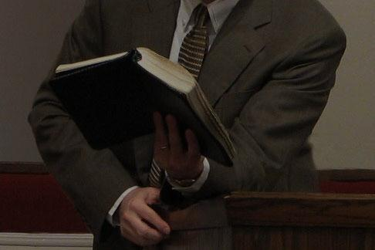
More Through Less
“And whoever compels you to go one mile, go with him two” (Matthew 5:41, NKJV)
A PARADOX

Slide 10
In order for us to understand the meaning of our text under consideration, we must acknowledge the Christian's higher standard of conduct by which we direct our lives

Slide 11
We live under a very unique Law!
We are members of the kingdom of Christ
In this kingdom, we guide our lives by the Law of Christ (e.g. the Sermon on the Mount, the New Covenant)
This higher Law is completely different from any other law

Slide 12

Most of the time, Christ’s Law will not make any sense to those who do not understand His teaching. This includes, Christians and non-Christians.

Slide 13
Let us consider the background of our text under consideration
“And whoever compels you to go one mile, go with him two” (Matthew 5:41, NKJV)

Slide 14
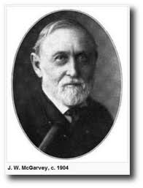
J.W. McGarvey
The custom alluded here is said to have originated with Cyrus, king of Persia, and it empowered a government courier to impress both men and horses to help him forward. The exercise of this power by the Romans was exceedingly distasteful to the Jews, and this circumstance gave especial pertinency to the Savior’s mention of it.
(A commentary on Matthew-Mark, p. 59)

Slide 15
The people’s new testament notes
“Compel thee to go a mile”. In those days, when there were no stages, railroad trains, postal lines, or regular means of conveyance, it was common for officers traveling to impress men to assist them on the route. It was a necessary, but oppressive, exaction. Christ directs to yield the service, and double it rather than refuse it.
A mile. A Roman word from mille, a thousand. A Roman mile was a thousand paces, 1,520 yards.

Slide 16
“Compel to go”: Gr. ἀγγαρεύω
Of Persian origin, and after being received into the Gr. Language, passed also into use among the Jews and Romans. The aggaroi, couriers, had authority to press into their service men, horses, ships or anything which came in their way and which might serve to hasten their journey. Therefore, this word means to be a courier, a messenger; By implication to press into public service.
Strong's Dictionary, 29
Word Study

Slide 17
“Compel to go”: Gr. ἀγγαρεύω
To compel, forcibly to impress someone to service, to compel him to serve whether he liked it or not.
Fritz Rienecker, A languistic Key to the Greek New Testament, p. 16

Slide 18
“Compel to go”: Gr. ἀγγαρεύω
This is the same word that appears in Matthew 27:32,
“And as they were coming out, they found a man of Cyrene named Simon, whom they pressed into service to bear His cross” (NASB).

Slide 19
The meaning of the Text
“And whoever compels you to go one mile, go with him two” (Matthew 5:41, NKJV)
Jesus teaches us that we are to give up our liberty in order to help or serve others. In other words, we must be willing to help those who ask or demand our help. We must do so with the right attitude!

Slide 20
The meaning of the Text
The religion of the second mile is performance beyond the call of duty, or doing more than one’s duty. Going the extra mile is to do more than is expected. When a man walks the first mile he becomes a candidate for the second. God’s people must go beyond the minimum requirements.
Joe Gilmore, The Sermon on the Mount, p. 141

Slide 21
Jesus Expects Us to Be Different
The Roman practice of commandeering civilians to carry military equipment or a soldier’s personal items was especially infuriating to the Jewish population of Palestine
(College Press Commentary)
WE MUST BE DIFFERENT!!

Slide 22
What the text is not saying
Jesus is not saying that we are to engage in the kind of help that causes us to violate the Word of God. In other words, we must not practice anything that goes contrary to the will of God.

Slide 23

Lets analyze the Greek grammar of the text under consideration

Slide 24
The Verb “Go” In The Greek
ὕπαγε
2 Person Singular (you)
Present Tense (continuous action)
Active Voice (subject does the action)
Imperative Mood (a command to obey)

Slide 25
Why is it MORE THROUGH LESS?
The Practical Aspect of our lesson

Slide 26

Let us consider the blessings of doing what Jesus commands us here in Matthew 5:41

Slide 27
# 1
We enjoy the opportunity to show our neighbor that we love him by serving him (Mark 12:30-31; Philippians 2:1-4)

Slide 28
# 2
We avoid displaying a worldly attitude which is contrary to the will of God
(Ephesians 4:31-32; Luke 6:27)

Slide 29
Ephesians 4:31-32
Let all bitterness, wrath, anger, clamor, and evil speaking be put away from you, with all malice. And be kind to one another, tender hearted, forgiving one another, even as God in Christ forgave you (NKJV)

Slide 30
Luke 6:27-28
But I say to you who hear: Love your enemies, do good to those who hate you, bless thowe who curse you, and pray for those who spitefully use you (NKJV)

Slide 31
# 3
We enjoy the opportunity to show submission to those who require our help; especially the laws of the land (Romans 13:1-7; Ephesians 6:5-8; 1 Peter 2:13-17).

Slide 32
# 4
We enjoy the opportunity to speak to others about spiritual matters (Mark 16:15)

Slide 33
# 5
We enjoy the opportunity to cultivate and develop in our lives patience and self control
(2 Peter 1:6)

Slide 34
# 6
We enjoy the opportunity to show others that we are different from the world. We become good examples to others!
(Matthew 5:43-48; 5:16)

Slide 35
# 7
We follow the example of those who went the extra mile (1 Corinthians 11:1; Philippians 3:17; 3 John 11; The Good Samaritan, Philemon, Paul, Jesus Christ and many more)

Slide 36
# 8
We show obedience to the Son of God, Jesus Christ (John 14:15; James 1:22-25)
Remember the command!

Slide 37
The Verb “Go” In The Greek
ὕπαγε
2 Person Singular (you)
Present Tense (continuous action)
Active Voice (subject does the action)
Imperative Mood (a command to obey)

Slide 38
We receive more through less when we make these blessings ours, by practicing what the Lord commands!

Slide 39
Let Us Consider Some Practical Examples of the Extra Mile Principle!

Slide 40
Church involvement requires going the extra mile (Evangelism, visitation, preaching, teaching, Ushering, etc.)
Hospitality requires going the extra mile (natural disasters, etc.)
Matters of opinion require going the extra mile (carpet, color, etc.)

Slide 41

As we close this lesson, let me encourage each of you to do the following:

Slide 42
Let us have a deep appreciation for the higher standard of conduct that we have in Jesus Christ
Let us continue to study the Scriptures so that we may strengthen our faith. There are some Christians that have left the faith because of a lack of knowledge
Let us strive to be different at all times!
Let us put others first so that we may please our heavenly Father

Slide 43
THANK YOU FOR YOUR KIND ATTENTION!
GOD BLESS YOU!

